Slide 1
Web Technology
Unit -4

Slide 2
Objectives
Web Services: Introduction to Service-Oriented Architectures, XML basics, SOAP, SOAP
message structure, WSDL, UDDI, Overview of Grid and Cloud Computing.
Latest trends in Web technologies. A Case Study for developing interactive web applications

Slide 3
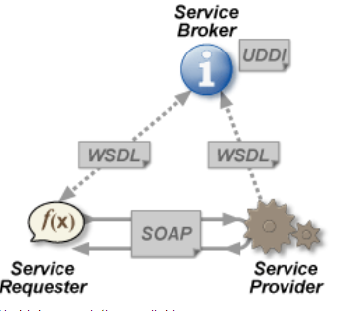
Web Services
A Web service is a method of communication between two electronic devices over the web (internet).
The W3C defines a "Web service" as "a software system designed to support interoperable machine-to-machine interaction over a network".
It has an interface described in a machine-processable format (specifically Web Services Description Language, known by the acronym WSDL).
Other systems interact with the Web service in a manner prescribed by its description using SOAP messages, typically conveyed using HTTP with an XML serialization in conjunction with other Web-related standards."

Slide 4
What is a Web Service?
A programmable application component that is accessible via standard Internet protocols
Web page with functions
Available for a variety of clients
Examples: stock quotes, traffic conditions, calculators, news, weather, et cetera

Slide 5
Technologies Used
Standard way to represent data
  XML (and XML schemas)
Common, extensible message format
  SOAP
Common, extensible contract language
  Web Services Description Language (WSDL)
Way to discover service providers
  Universal Description, Discovery, and Integration (UDDI)

Slide 6
Web services?
“Web services are web apps that return data, not presentation. Since applications are typically about accessing data, web services are poised to become the next evolutionary step in distributed software development...”
Why?
  cross-platform application development
  legacy system integration
Web server
obj
obj
XML
obj
obj
Notes:
9. Web Services
2003
© 2003 Microsoft

Slide 7
Overview
Web services involve many technologies:
  WSDL to learn about web service
  to call: proxy objects, SOAP, XML, HTTP and .ASMX pages
web service
client app
WSDL
Web server
obj
obj
method call
method call
obj
.asmx
proxy
SOAP msg (XML)
HTTP request

Slide 8
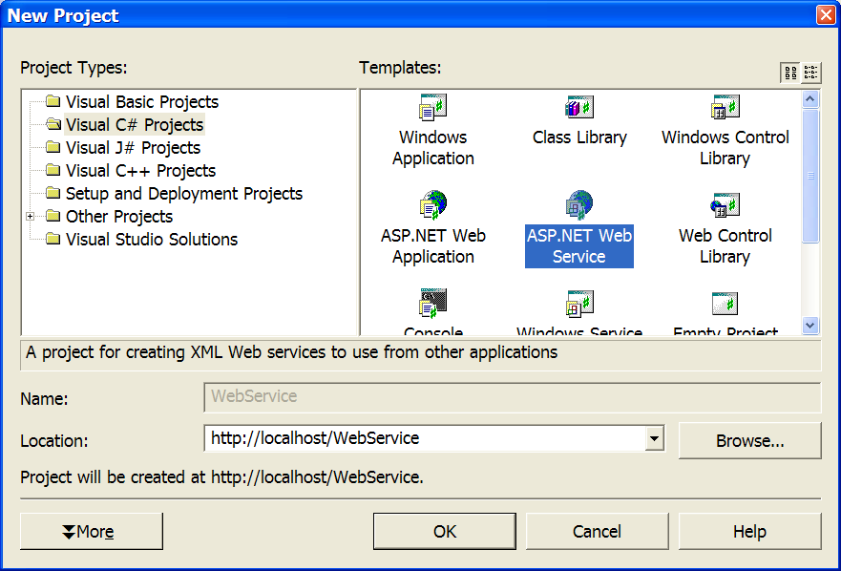
(1) Building a web service
Start by creating a project of type “ASP.NET Web Service”

Slide 9
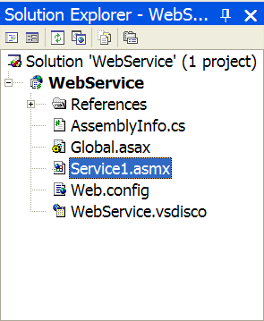
A web service is…
One or more objects that respond to web-based method calls
  there is no GUI design to a web service
  only raw classes with methods…
public class Service1 : System.Web.Services.WebService
{
.
.
.
}
Notes:
9. Web Services
2003
© 2003 Microsoft

Slide 10
Example
Looks like C#, but keep in mind these are web-based methods
  client could be calling from any platform
  parameters passed using XML
inherit
public class Service1 : System.Web.Services.WebService
{
[WebMethod]
public int Add(int x, int y)
{
return x + y;
}
[WebMethod]
public string[] Attendees()
{
<<open DB, read attendees into array, return it>>
}
}
attribute
Notes:
9. Web Services
2003
© 2003 Microsoft

Slide 11
How Web Service comes into existence?
As i have mention before that Web Service is nothing but means for
interacting with objects over the Internet.
1. Initially Object - Oriented Language comes which allow us to interact with two object within same application.
2. Than comes Component Object Model (COM) which allows to interact two objects on the same computer, but in different applications.
3. Than comes Distributed Component Object Model (DCOM) which allows to interact two objects on different computers, but within same local network.
4. And finally the web services, which allows two object to interact internet. That is it allows to interact between two object on different computers and even not within same local network.

Slide 12
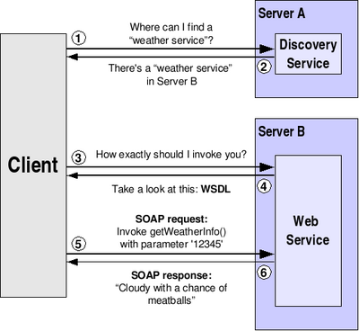
Web Service Invocation

Slide 13
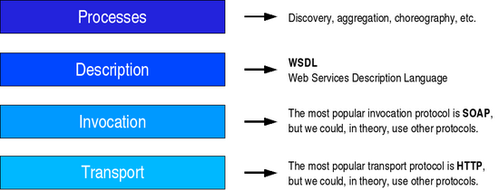
Web Services Architecture
Service Processes: This part of the architecture generally involves more than one Web service. For example, discovery belongs in this part of the architecture, since it allows us to locate one particular service from among a collection of Web services.
Service Description: One of the most interesting features of Web Services is that they are self-describing.
Service Invocation: SOAP is by far the most popular choice for Web Services.
Transport: Finally, all these messages must be transmitted somehow between the server and the client. The protocol of choice for this part of the architecture is HTTP (HyperText Transfer Protocol

Slide 14
SOAP
SOAP (Simple Object Access Protocol) is a simple protocol for exchange of information. It is based on XML and consists of three parts:
1. A SOAP envelope (describing what's in the message and how to process it);
2. A set of encoding rules, and
3. A convention for representing RPCs (Remote Procedure Calls) and responses.

Slide 15
SOAP
A simple, XML-based protocol for exchanging structured and type information on the Web
Industry standard
Lightweight and XML-based protocol
Can support different protocols and formats: HTTP, SMTP, and MIME
SOAP message

Slide 16
WSDL
WSDL (Web Services Description Language) defines the XML grammar for describing services as collections of communication endpoints capable of exchanging messages.
Companies can publish WSDLs for services they provide and others can access those services using the information in the WSDL. Links to WSDLs are usually offered in a company’s profile in the UDDI registry.

Slide 17
UDDI
UDDI (Universal Description, Discovery, and Integration) is a specification designed to allow businesses of all sizes to benefit in the new digital economy.
There is a UDDI registry, which is open to everybody. Membership is free and members can enter details about themselves and the services they provide. Searches can be performed by company name, specific service, or types of service.
This allows companies providing or needing web services to discover each other, define how they interact over the Internet and share such information in a truly global and standardized fashion.

Slide 18
WEB SERVICES
Introduction to Service Oriented Architecture
XML
SOAP, SOAP Message Structure
WSDL
UDDI

Slide 19
WEB SERVICES
Web Service is an application that is designed to interact directly with other applications over the internet. In simple sense, Web Services are means for interacting with objects over the Internet. Web Service is:
    Language Independent
    Protocol Independent
    Platform Independent
    It assumes a stateless service architecture.

Slide 20
SERVICE ORIENTED ARCHITECTURE
Service Oriented Architecture or SOA for short is a new architecture for the development of loosely coupled distributed applications.
In fact service-oriented architecture is collection of many services in the network. These services communicate with each other and the communications involves data exchange & even service coordination.
Earlier SOA was based on the DCOM. Nowadays SOA is based on the Web Services.

Slide 21
Service Oriented Architecture
The actual definition goes here
"A service-oriented architecture can be defined as a group of services, which communicate with each other. The process of communication involves either simple data passing or it could involve two or more services coordinating some activity. Some means of connecting services to each other is needed."

Slide 22

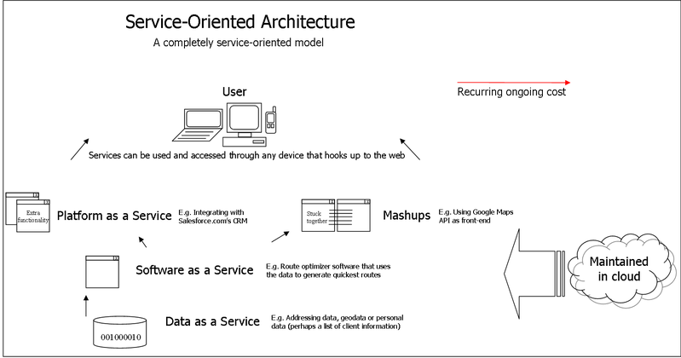
SOA

Slide 23
SERVICE ORIENTED ARCHITECTURE
Broadly SOA can be classified into two terms: Services and
Connections.
Services:
    A service is a function or some processing logic or business processing that is well-defined, self-contained, and does not depend on the context or state of other services.
    Example of Services is Weather Services, which can be used to get the weather information. Any application on the network can use the service of the Weather Service to get the weather information.

Slide 24
SERVICE ORIENTED ARCHITECTURE
Connections:
    Connections means the link connecting these self-contained distributed services with each other, it enable client to Services communications.
    In case of Web services SOAP over HTTP is used to communicate the between services.

Slide 25
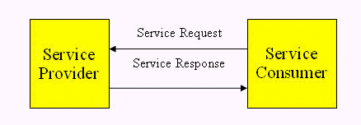
SERVICE ORIENTED ARCHITECTURE
It shows how a service consumer sends a service request to a service provider.
After accepting the request, service provider send a message to service consumer.

Slide 26
What is XML?
XML stands for Extensible Markup Language.
XML is a markup language much like HTML.
XML was designed to carry data, not to display data.
XML tags are not predefined. You must define your own tags
XML is designed to be self-descriptive.
XML is designed to transport and store data.
XML is important to know, and very easy to learn.

Slide 27
The Difference Between XML and HTML
XML is not a replacement for HTML.
XML and HTML were designed with different goals:
  XML was designed to transport and store data, with focus on what data is
  HTML was designed to display data, with focus on how data looks
HTML is about displaying information, while XML is about carrying information.

Slide 28
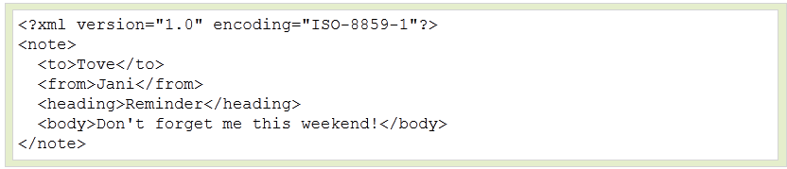
XML Tree
XML documents form a tree structure that starts at "the root" and
branches to "the leaves".
An Example XML Document
XML documents use a self-describing and simple syntax:
The first line is the XML declaration. It defines the XML version (1.0) and the encoding used.
The next line describes the root element of the document.
The next 4 lines describe 4 child elements of the root.
And finally the last line defines the end of the root element.

Slide 29
XML Tree
XML documents must contain a root element. This element is "the parent" of all other elements.
All elements can have sub elements (child elements):
<root>
<child>
<subchild>.....</subchild>
</child>
</root>
The terms parent, child, and sibling are used to describe the relationships between elements. Parent elements have children. Children on the same level are called siblings.
All elements can have text content and attributes (just like in HTML).

Slide 30
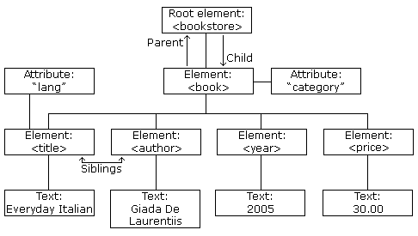
XML Tree : Example

Slide 31
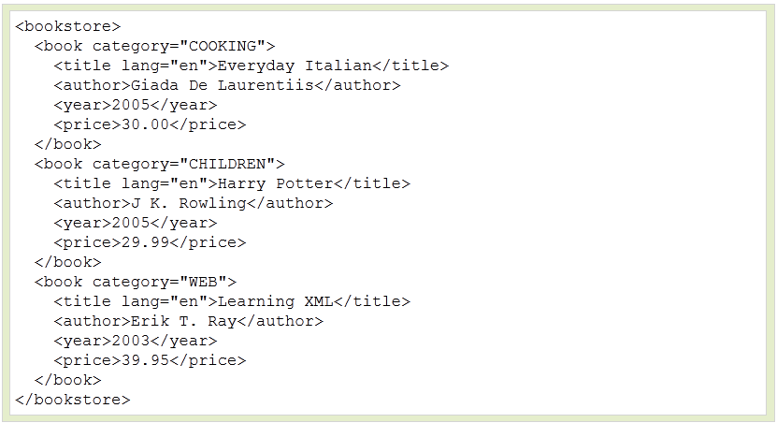
XML Tree : Example
The image above represents one book in the XML below:

Slide 32
XML Syntax Rules
The syntax rules of XML are very simple and logical. The rules are
easy to learn, and easy to use.
All XML Elements Must Have a Closing Tag.
In HTML, some elements do not have to have a closing tag:
<p>This is a paragraph.
<br>
In XML, it is illegal to omit the closing tag. All elements must have a closing tag:
<p>This is a paragraph.</p>
<br />
XML Tags are Case Sensitive
XML tags are case sensitive. The tag <Letter> is different from the tag <letter>.

Slide 33
XML Syntax Rules
XML Elements Must be Properly Nested
  In HTML, you might see improperly nested elements:
  <b><i>This text is bold and italic</b></i>
  In XML, all elements must be properly nested within each other:
  <b><i>This text is bold and italic</i></b>
XML Documents Must Have a Root Element
XML documents must contain one element that is the parent of all other elements. This element is called the root element.
<root>
<child>
<subchild>.....</subchild>
</child>
</root>

Slide 34
XML Syntax Rules
XML Attribute Values Must be Quoted
XML elements can have attributes in name/value pairs just like in HTML.
In XML, the attribute values must always be quoted.
<note date="12/11/2007">
<to>Tove</to>
<from>Jani</from>
</note>
Comments in XML
The syntax for writing comments in XML is similar to that of HTML.
<!-- This is a comment -->
White-space is Preserved in XML
HTML truncates multiple white-space characters to one single white-space:
HTML: Hello Tove Output: Hello Tove
With XML, the white-space in a document is not truncated.

Slide 35
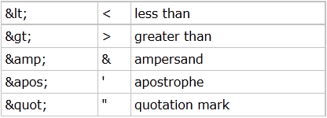
XML Syntax Rules
Entity References
Some characters have a special meaning in XML.
If you place a character like "<" inside an XML element, it will generate an error because the parser interprets it as the start of a new element.
This will generate an XML error:
<message>if salary < 1000 then</message>
To avoid this error, replace the "<" character with an entity reference:
<message>if salary &lt; 1000 then</message>
There are 5 predefined entity references in XML:

Slide 36
XML Elements
What is an XML Element?
An XML element is everything from (including) the element's start tag to (including) the element's end tag.
An element can contain:
    other elements
    text
    attributes
    or a mix of all of the above...
XML Naming Rules
XML elements must follow these naming rules:
    Names can contain letters, numbers, and other characters
    Names cannot start with a number or punctuation character
    Names cannot start with the letters xml (or XML, or Xml, etc)
    Names cannot contain spaces
    Any name can be used, no words are reserved.

Slide 37
XML Elements
XML Elements are Extensible
XML elements can be extended to carry more information.
Look at the following XML example:
<note>
<to>Tove</to>
<from>Jani</from>
<body>Important Task</body>
</note>
Imagine that the author of the XML document added some extra information to it:
<note>
<date>2008-01-10</date>
<to>Tove</to>
<from>Jani</from>
<heading>Reminder</heading>
<body>Important Task</body>
</note>

Slide 38
XML Attributes
In HTML, attributes provide additional information about elements:
<img src="computer.gif">
<a href="demo.asp">
Attributes often provide information that is not a part of the data. In the example below, the file type is irrelevant to the data, but can be important to the software that wants to manipulate the element:
<file type="gif">computer.gif</file>
XML Attributes Must be Quoted

Slide 39
XML Elements vs. Attributes
Take a look at these examples:
<person gender="female">
<firstname>Anna</firstname>
<lastname>Smith</lastname>
</person>
<person>
<gender>female</gender>
<firstname>Anna</firstname>
<lastname>Smith</lastname>
</person>
In the first example gender is an attribute. In the last, gender is an element. Both examples provide the same information.

Slide 40
Where to Use Attributes?
Some of the problems with using attributes for data are:
    attributes cannot contain multiple values (elements can)
    attributes cannot contain tree structures (elements can)
    attributes are not easily expandable (for future changes)
Use XML Attributes for Metadata
    Sometimes ID references are assigned to elements. These IDs can be used to identify XML elements in much the same way as the id attribute in HTML.
    Metadata (data about data) should be stored as attributes, and the data itself should be stored as elements.

Slide 41
XML Validation
XML with correct syntax is "Well Formed" XML.
XML validated against a DTD is "Valid" XML.
Well Formed XML Documents
A "Well Formed" XML document has correct XML syntax.
The syntax rules were described in the previous Slides:
    XML documents must have a root element
    XML elements must have a closing tag
    XML tags are case sensitive
    XML elements must be properly nested
    XML attribute values must be quoted

Slide 42
XML Validation
Valid XML Documents
A "Valid" XML document is a "Well Formed" XML document, which also conforms to the rules of a Document Type Definition (DTD):
<?xml version="1.0" encoding="ISO-8859-1"?>
<!DOCTYPE note SYSTEM "Note.dtd">
<note>
<to>Tove</to>
<from>Jani</from>
<heading>Reminder</heading>
<body> Important Task</body>
</note>
The DOCTYPE declaration in the example above, is a reference to an external DTD file.
The purpose of a DTD is to define the structure of an XML document. It defines the structure with a list of legal elements.

Slide 43
Displaying XML with CSS
It is possible to use CSS to format an XML document.
<?xml version="1.0" encoding="ISO-8859-1"?>
<?xml-stylesheet type="text/css" href="cd_catalog.css"?>
<CATALOG>
<CD>
<TITLE>Empire Burlesque</TITLE>
<ARTIST>Bob Dylan</ARTIST>
<COUNTRY>USA</COUNTRY>
<COMPANY>Columbia</COMPANY>
<PRICE>10.90</PRICE>
<YEAR>1985</YEAR>
</CD>
</CATALOG>

Slide 44
What is SOAP?
SOAP stands for Simple Object Access Protocol
SOAP is a communication protocol
SOAP is for communication between applications
SOAP is a format for sending messages
SOAP communicates via Internet
SOAP is platform independent
SOAP is language independent
SOAP is based on XML
SOAP is simple and extensible

Slide 45
SOAP Syntax
SOAP Building Blocks
A SOAP message is an ordinary XML document containing the following elements:
    An Envelope element that identifies the XML document as a SOAP message
    A Header element that contains header information
    A Body element that contains call and response information
    A Fault element containing errors and status information
Syntax Rules
Here are some important syntax rules:
    A SOAP message MUST be encoded using XML
    A SOAP message MUST use the SOAP Envelope namespace
    A SOAP message MUST use the SOAP Encoding namespace
    A SOAP message must NOT contain a DTD reference

Slide 46
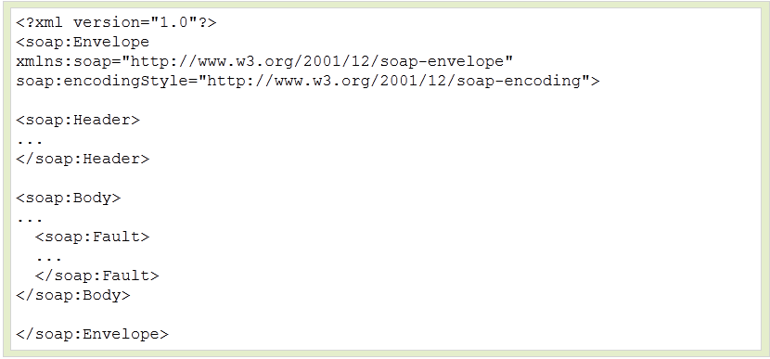
SOAP Syntax
Skeleton SOAP Message

Slide 47
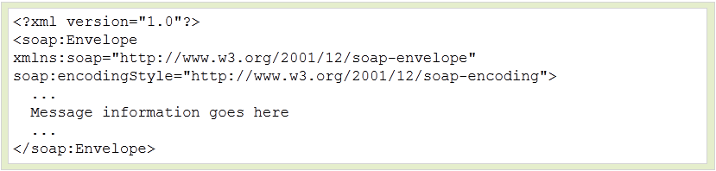
SOAP Envelope
The SOAP Envelope element is the root element of a SOAP message.
The SOAP Envelope Element
The required SOAP Envelope element is the root element of a SOAP message. This element defines the XML document as a SOAP message.
Example:

Slide 48
SOAP Envelope
The xmlns:soap Namespace
    Notice the xmlns:soap namespace in the example above. It should always have the value of: "http://www.w3.org/2001/12/soap-envelope".
    The namespace defines the Envelope as a SOAP Envelope.
    If a different namespace is used, the application generates an error and discards the message.
The encodingStyle Attribute
The encodingStyle attribute is used to define the data types used in the document. This attribute may appear on any SOAP element, and applies to the element's contents and all child elements.

Slide 49
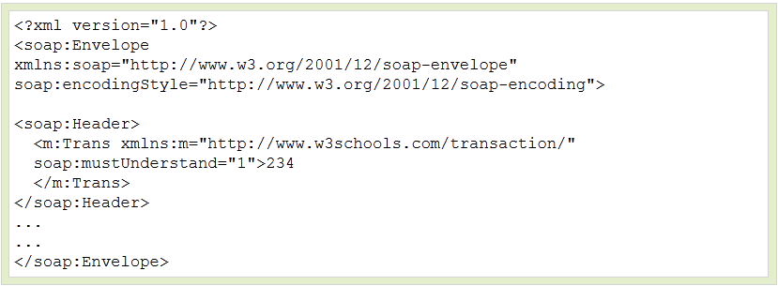
SOAP Header Element
The SOAP Header element contains header information.
The optional SOAP Header element contains application-specific information (like authentication, payment, etc) about the SOAP message.
If the Header element is present, it must be the first child element of the Envelope element.

Slide 50
SOAP Header Element
The mustUnderstand Attribute
The SOAP mustUnderstand attribute can be used to indicate whether a header entry is mandatory or optional for the recipient to process.
If you add mustUnderstand="1" to a child element of the Header element it indicates that the receiver processing the Header must recognize the element. If the receiver does not recognize the element it will fail when processing the Header.
Syntax
soap:mustUnderstand="0|1“

Slide 51
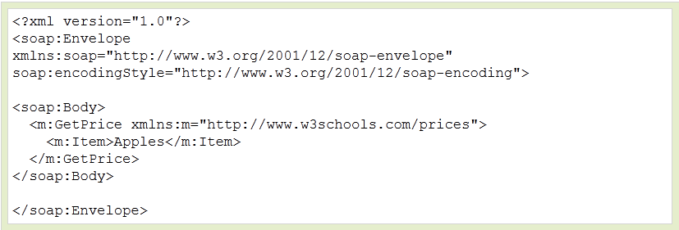
SOAP Body Element
The required SOAP Body element contains the actual SOAP
message intended for the ultimate endpoint of the message.
Example: Request message
The example above requests the price of apples. Note that the GetPriceand the Item elements above are application-specific elements. They are not a part of the SOAP namespace.

Slide 52
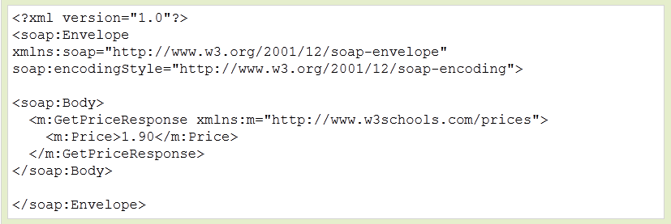
SOAP Body Element
Example: Response message
A SOAP response could look something like this:
.

Slide 53
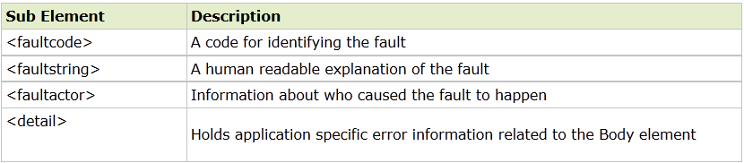
SOAP Fault Element
The SOAP Fault element holds errors and status information for a SOAP
message.
The SOAP Fault Element
    The optional SOAP Fault element is used to indicate error messages.
    If a Fault element is present, it must appear as a child element of the Body element. A Fault element can only appear once in a SOAP message.
    The SOAP Fault element has the following sub elements:

Slide 54
UDDI
Universal Description, Discovery and Integration
WLDL
Web Services Description Language

Slide 55
UDDI
Universal Description, Discovery and Integration (UDDI) is a platform-independent, Extensible Markup Language(XML)-based registry for businesses worldwide to list themselves on the Internet and a mechanism to register and locate web service applications.
UDDI is an open industry initiative, sponsored by the Organization for the Advancement of Structured Information Standards (OASIS), enabling businesses to publish service listings and discover each other and define how the services or software applications interact over the Internet.

Slide 56
UDDI Contd..
UDDI was originally proposed as a core Web service standard . It is designed to be interrogated by SOAP messages and to provide access to Web Services Description Language (WSDL) documents describing the protocol bindings and message formats required to interact with the web services listed in its directory.
UDDI is a platform-independent framework for describing services, discovering businesses, and integrating business services by using the Internet.
    UDDI stands for Universal Description, Discovery and Integration .
    UDDI is a directory for storing information about web services .
    UDDI is a directory of web service interfaces described by WSDL.
    UDDI communicates via SOAPUDDI is built into the Microsoft .NET platform

Slide 57
UDDI Benefits
Any industry or businesses of all sizes can benefit from UDDI. Before UDDI, there was no Internet standard for businesses to reach their customers and partners with information about their products and services. Nor was there a method of how to integrate into each other's systems and processes . Problems the UDDI specification can help to solve:
  Making it possible to discover the right business from the millions currently online
  Defining how to enable commerce once the preferred business is discovered

Slide 58
UDDI Benefits
  Reaching new customers and increasing access to current customers
  Expanding offerings and extending market reach
  Solving customer-driven need to remove barriers to allow for rapid participation in the global Internet economy
  Describing services and business processes programmatically in a single, open, and secure environment

Slide 59



UDDI Diagram
1.
SW companies, standards bodies, and programmers populate the registry with
descriptions of different types of services
4.
Marketplaces, search engines, and business apps query the registry to discover services at other companies
2.
Business
Registrations
Service Type
Registrations
Businesses populate
the registry with
descriptions of the services they support
5.
3.
UBR assigns a programmatically unique identifier to each service and business registration
Business uses this data to facilitate easier integration with each other over the Web

Slide 60
UDDI Features
UDDI specifies:
  Protocols for accessing a registry for Web services
  Methods for controlling access to the registry
  Mechanism for distributing or delegating records to other registries

Slide 61
UDDI Registry Service
The UDDI specifications define a registry service for Web services and for other electronic and non-electronic services
A UDDI registry service is a Web service that support the description and discovery of service providers, service implementations, and service metadata
UDDI Registry Types :
  Private registries:
    Isolated from the public network, firewalled
    Restricted access
    No shared data
  Public registries:
    Unrestricted open and public access
    Data is shared with other registries
  Affiliated registries
    Controlled environment
    Access limited to authorized clients
    Data shared in a controlled manner

Slide 62
WSDL
WSDL stands for Web Services Description Language.
WSDL is a document written in XML. The document describes a Web service. It specifies the location of the service and the operations (or methods) the service exposes.
A WSDL document is just a simple XML document.
It contains set of definitions to describe a web service.
The WSDL Document Structure
A WSDL document describes a web service using these major elements:
Element | Defines
<types> | The data types used by the web service
<message> | The messages used by the web service
<port Type> | The operations performed by the web service
<binding> | The communication protocols used by the web service
<service>

Slide 63
WSDL
WSDL describes a service’s exposed interface
It is what a client sees of your service
WSDL includes information about
  The data types it uses
  Parameters it requires and returns
  Groupings of functionality
  The protocol to be used to access the
  service
  The location or address of the service

Slide 64
A WSDL document is an XML document
Example:
<?xml version="1.0" encoding="UTF-8"?>
<definitions>
<types>
<!– define the types here using XML Schema →
</types>
<message>
<!– XML messages the web service uses are defined here →
</message>
<portType>
<!– define the input and output parameters here -→
</portType>
<binding>
<!– define the network protocol here →
</binding>
<service>
<!– location of the service →
</service>
</definitions>

Slide 65

What is Grid Computing?
  “A computational grid is a hardware and software infrastructure that provides dependable, consistent, pervasive, and inexpensive access to high-end computational capabilities.”
  -”The Grid: Blueprint for a New Computing Infrastructure”, Kesselman & Foster
  Criteria for a Grid:
  Coordinates resources that are not subject to centralized control.
  Uses standard, open, general-purpose protocols and interfaces.
  Delivers nontrivial qualities of service

Slide 66
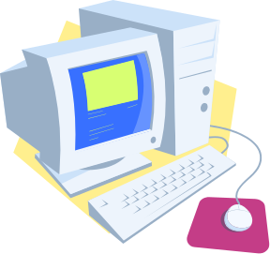

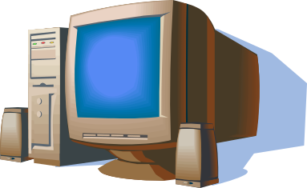

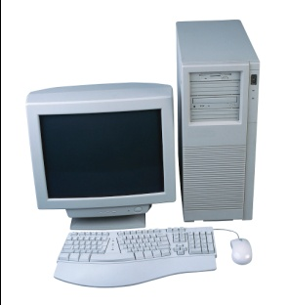
Grid Architecture
Autonomous, globally distributed computers/clusters

Slide 67
What is Grid?
A type of parallel and distributed system that
enables the sharing, exchange, selection, & aggregation of geographically distributed “autonomous” resources:
  Computers – PCs, workstations, clusters, supercomputers,
  laptops, notebooks, mobile devices, PDA, etc;
  Software – e.g., ASPs renting expensive special purpose applications on demand;
  Catalogued data and databases – e.g. transparent access to
  human genome database;
  Special devices/instruments – e.g., radio telescope – SETI@Home searching for life in galaxy.
  People/collaborators.
depending on their availability, capability, cost, and user QoS requirements.

Slide 68
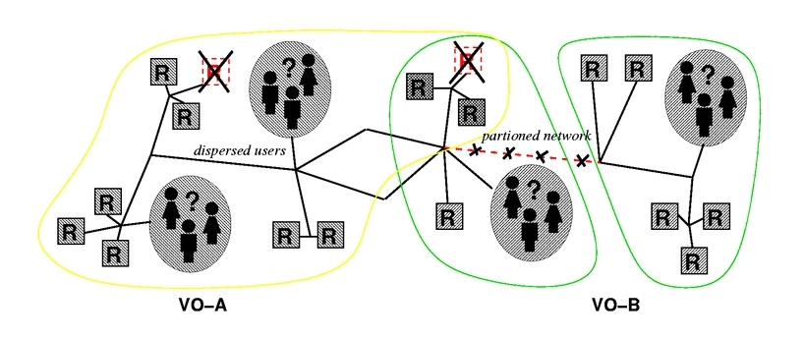
The Grid
“Resource sharing & coordinated problem solving in dynamic, multi-institutional virtual organizations”
Enable integration of distributed resources
Using general-purpose protocols & infrastructure
To achieve better-than-best-effort service
Notes:
What is not a Grid?
A cluster, network attached storage device, scientific instrument, network, etc.
Cycle scavenging just one Grid use case

Slide 69

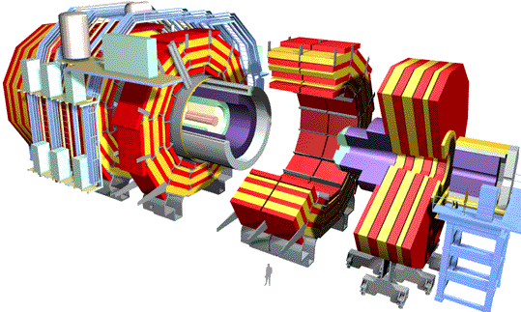
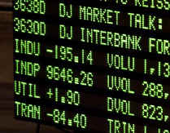



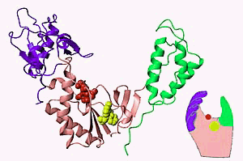
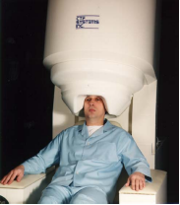

How Are Grids Used?
Utility computing
High-performance computing
Collaborative design
Financial modeling
E-Business
High-energy physics
Drug discovery
Life sciences
Data center automation
E-Science
Natural language
processing & Data Mining
Collaborative data-sharing

Slide 70

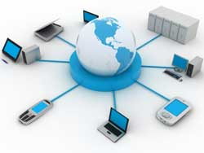


Evolution of Cloud Computing
Cloud Computing
SaaS Computing
Utility Computing
Next-Generation
Internet computing
Next-Generation
Data Centers
Grid Computing
Network-based
subscriptions
to applications
Gained momentum
in 2001
Offering
computing
resources as a
metered
service
Introduced in
late 1990s
Solving large
problems with
Parallel
computing
Made
mainstream
By Global
Alliance
Notes:
Date

Slide 71


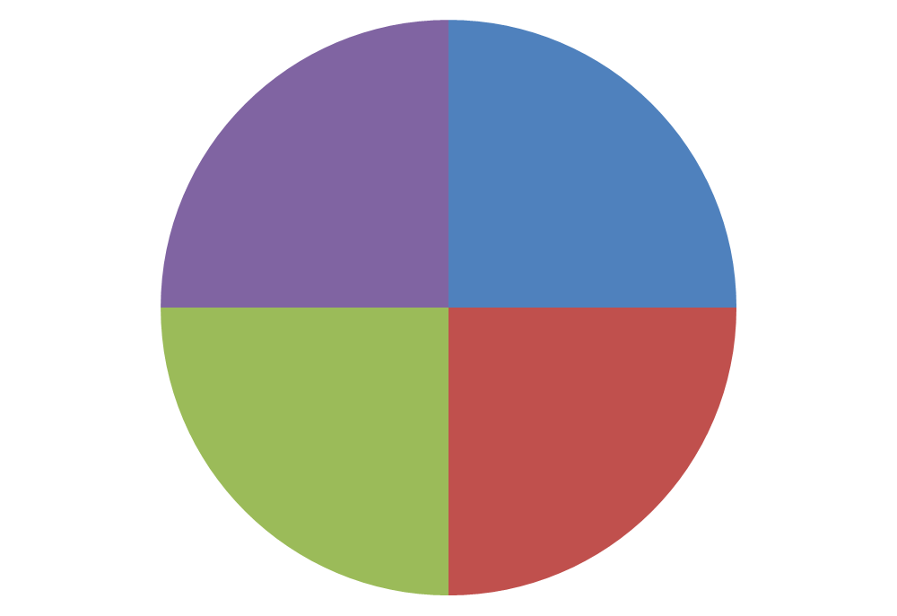


Technology Roadmap to Cloud
Service oriented architecture infrastructure
Rapid provisioning of IT resources, massive scaling
Dynamic service mgmt
Energy saving via auto workload distribution
IT assets & datacenters kept growing
Desperate system tools
Inconsistent processes
Soaring IT and power costs
Complex
Infrastructure
Sprawl
Cloud Computing
Technology Roadmap
to cloud
Virtualization
Physical Consolidation
Consolidate IT assets & datacenters
Standardize and centralize management
Streamline processes with ITIL best practices
Energy saving - Phase out inefficient HW

Slide 72
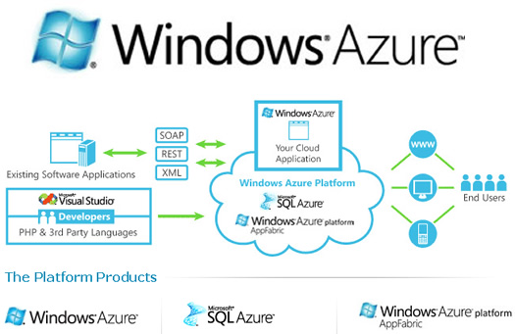
Window azure

Slide 73
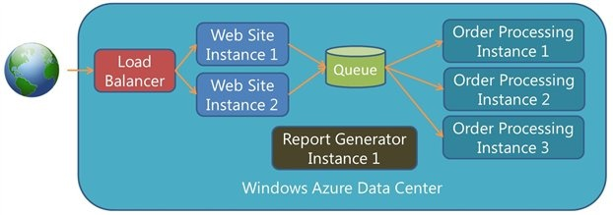
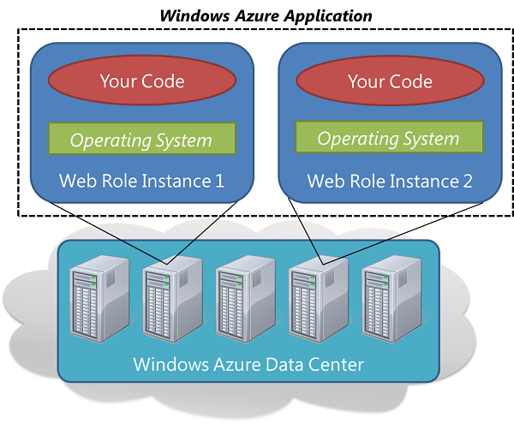
What is actually doing ?

Slide 74
Cloud computing
Changing the definition to share and reuse with less to pay and more to save…
21 countries to adapt to this change will we still stand in queue…(waiting for 2015 to get 1million jobs in same)

Slide 75
What is Cloud Computing?
“Cloud” is the aggregation of Servers, Low end computers and storage
hosting the program and data
Accessed via Internet anywhere from world
User Centric – Easier for group members to collaborate
Task Centric– User’s need is more important than features of application
Powerful – All resources together create a wealth of computing power
Programmable – Automated distribution of computing power and data across cloud. Data loss become a history now

Slide 76
What Cloud Computing “IS NOT”?
It is not Network Computing
  Application and Data are not confined to any specific Company’s Server
  No VPN Access
  Encompasses multiple companies, multiple servers and multiple
  networks
It is not Traditional Outsourcing
  Not a contract to host data by 3rd party Hosting Business
  No subcontracting for computing services for specific outside firm
Notes:
Date

Slide 77

Cloud Computing Characteristics
Accessibility
Agility
Service Management
Flexibility
User Metering
Cost Efficiency
Automation
Virtualization
Cloud Computing is a model of how IT should operate as a business!
Notes:
Date

Slide 78
Cloud Computing Framework
Cloud Framework System | Business Process as a Service
 | Application/Software as a Service
 | Platform as a Service
 | Infrastructure as a Service
Notes:
Date

Slide 79
Latest trends in web services

Slide 80
Silverlight
Silverlight is a powerful development tool for creating engaging, interactive user experiences for Web and mobile applications.
Silverlight is a free plug-in, powered by the .NET framework and compatible with multiple browsers, devices and operating systems, bringing a new level of interactivity wherever the Web works.
Netflix uses Silverlight to stream TV Episodes and Movies to PC and Mac in Standard Definition and HD where available.

Slide 81
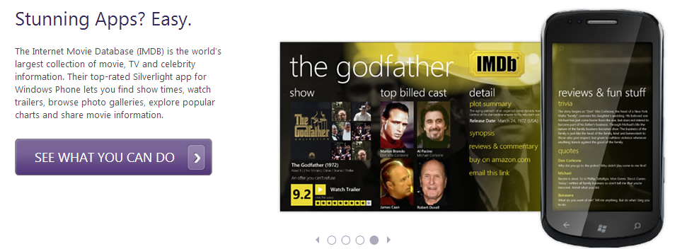
Silverlight

Slide 82
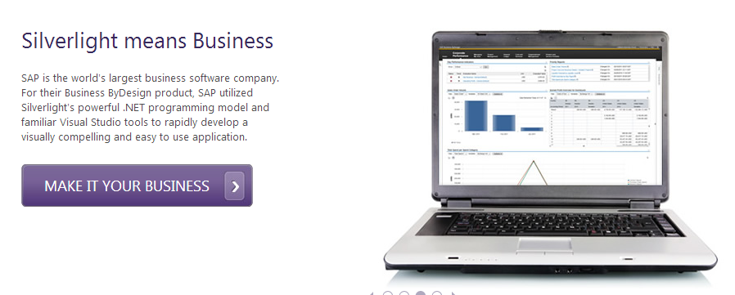
Silverlight

Slide 83
Microsoft Sharepoint
SharePoint makes it easy to store, sync and share all your important content. A new simplified user experience helps you streamline common tasks and create sites to keep teams in sync.
Developers can build modern apps and designers can build eye-catching websites and because it’s built in the cloud IT Pros can manage cost and meet the demands of compliance to manage risk.
By default, SharePoint has a Microsoft Office-like interface, and it is closely integrated with the Office suite. The web tools are designed to be usable by non-technical users. SharePoint can be used to provide intranet portals, document & file anagement, collaboration,social networks, extranets, websites, enterprise search, and business intelligence

Slide 84
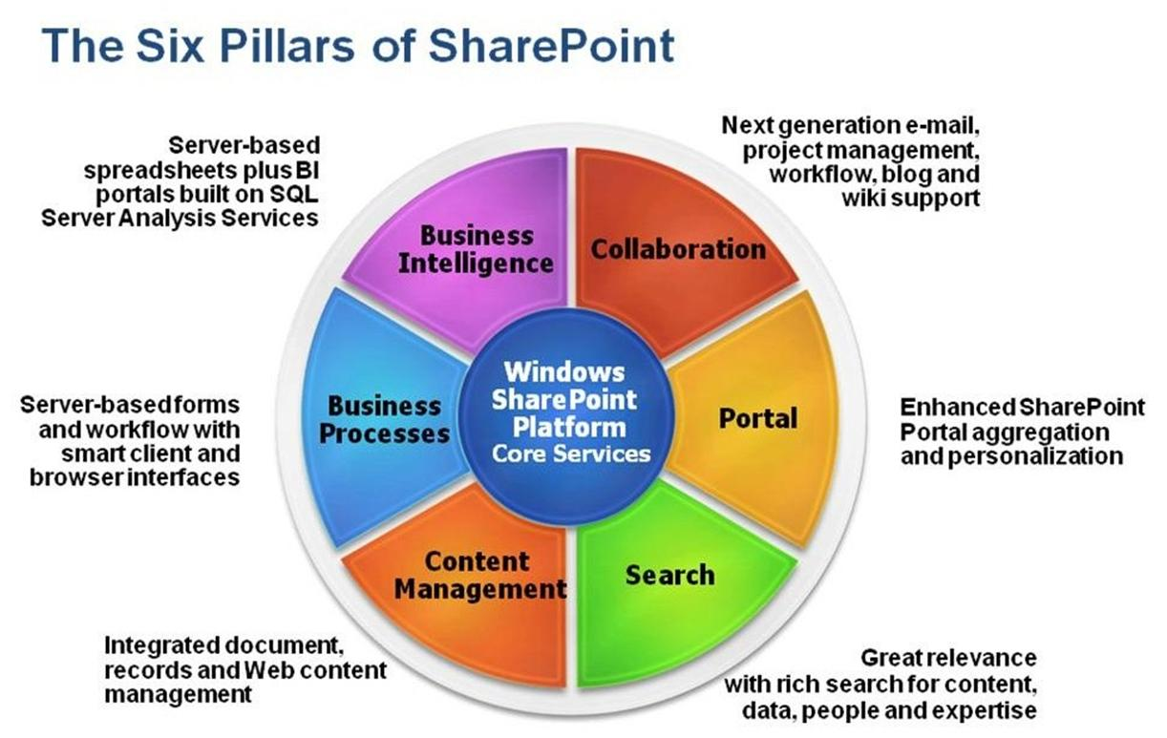
Share Point

Slide 85
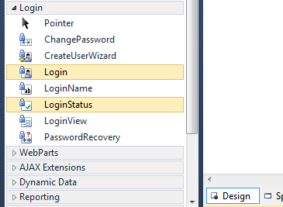
ADVANCE TOOLS
Login Controls
In ASP.NET applications now we have special built in login control that can incorporated directly to our asp.net application.
createUserWizard
Login
LoginStatus

Slide 86
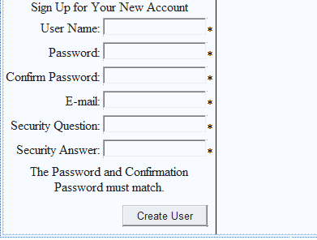
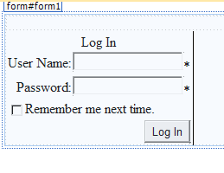
Login controls

Slide 87
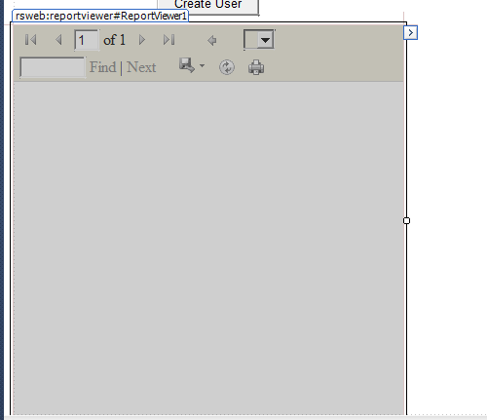
Reporting control
This control is to create final report as a output that can be printed.
Eg railway ticketing system we final get a report view of our booked ticket

Slide 88
Cont…
ASP.NET MVC
  ASP.NET MVC helps Web developers build compelling standards-based Web sites that are easy to maintain because it decreases the dependency among application layers by using the Model-View-Controller (MVC) pattern.
ASP.NET Chart Control
  The ASP.NET chart server control enables you to create ASP.NET pages applications that have simple, intuitive charts for complex statistical or financial analysis. The chart control supports the features like Data series, chart areas, axes, legends, labels, titles, and more.
Notes:
1. MVC provides complete control over the page markup. It also improves testability by inherently supporting Test Driven Development (TDD).
Web sites created using ASP.NET MVC have a modular architecture. This allows members of a team to work independently on the various modules and can be used to improve collaboration. For example, developers can work on the model and controller layers (data and logic), while the designer work on the view (presentation).
2.

Slide 89
ASP.NET Chart Control
The control includes the following features:
35 distinct chart types.
An unlimited number of chart areas, titles, legends, and annotations.
A wide variety of appearance settings for all chart elements.
3-D support for most chart types.
Smart data labels that can automatically fit around data points.
Strip lines, scale breaks, and logarithmic scaling.
More than 50 financial and statistical formulas for data analysis and transformation.
Simple binding and manipulation of chart data.
Support for common data formats such as dates, times, and currency.
Support for interactivity and event-driven customization, including client click events using Ajax.
State management.
Binary streaming.

Slide 90
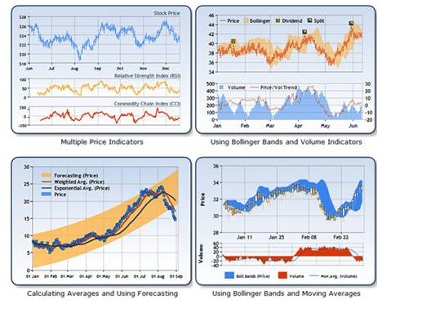
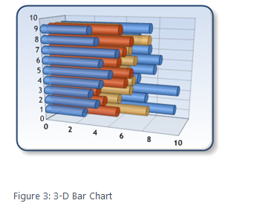
CHARTS

Slide 91
Amazon Web services
With EC2, customers create their own Amazon Machine Images (AMIs) containing an operating system, applications, and data, and they control how many instances of each AMI run at any given time.
Customers pay for the instance-hours (and bandwidth) they use, adding computing resources at peak times and removing them when they are no longer needed.
The EC2, Simple Storage Service (S3), and other Amazon offerings scale up to deliver services over the Internet in massive capacities to millions of users.

Slide 92
Short Questions
What is a web service. Where it is used?
What is service oriented architecture explain?
Where are Grid computing and cloud computing needed in web technology explain?
Write short notes on the following:
WSDL ,UDDI
What is SOAP message structure explain?
What is grid computing? How is it being used in web?

Slide 93
Long Questions
What is Service-Oriented Architectures? Explain the use with an example.
Write short notes on (any two):-
WSDL,
UDDI,
Cloud Computing,
Grid Computing
Where do we use SOAP protocol? Explain the SOAP message structure.

Slide 94
Long Questions
Explain web service? Why do we use web service in a web site, give examples?
Where do we use SOAP protocol? Explain the SOAP message structure?
What is Service-Oriented Architecture? Explain its benefits with examples?
Write short notes on (any two):-
WSDL, UDDI, Cloud Computing

Slide 95
Research Problem
Distributed Computing Environments
The complex distribution of computing power in the Internet makes it impossible to use the traditional programming paradigms to develop Web Computing applications. New approaches are being explored by our group, using the Mobile Agent paradigm. The main idea is to program small agents that migrate from one machine to another, using a small fraction of processing power at each stage, collecting information and making decisions based on their knowledge. From time to time, they may come back to their original creator machine, if a database is being built.
Much research concerning agents is being done around the world. However there is still a surprisingly low number of available platforms implementing them. We have built a reflective platform in Java (called Reflex) that provides a functional environment to test these ideas, with dynamic behavior.
For more Reference Check http://www.cwr.cl/areas.html

Slide 96
References
TEXT BOOKS:
1. K. K. Sharma, “Web Technology”, A.B. Publication Delhi, First Edition, 2008.
2. Stephen Walther, “ASP.NET”, Pearson Education, Second Edition, 2004.
3. Ethan Cerami, “Web Services”, O'Reilly Media, 2002.
4. Achyut S Godbole and Atul Kahate, “Web Technologies”, Tata McGraw Hill.
5. Heith Morneau, “Active Server Pages “, Vikas Publishing House.
REFERENCES:
1. Raj Kamal , “Internet and Web Technologies”, TMH.
2. Deitel, “Internet & World Wide Web , How to Program”, PHI.
3. V. K. Jain, “Advanced programming in Web Design”, Cyber tech.
4. Rick Dranell, “HTML4 unleashed”, Techmedia Publication, 2000.

